Slide 1
Surviving the angel of death: Chapter 1
Eva Mozes Kor and Lisa Rojany Buccieri

Slide 2
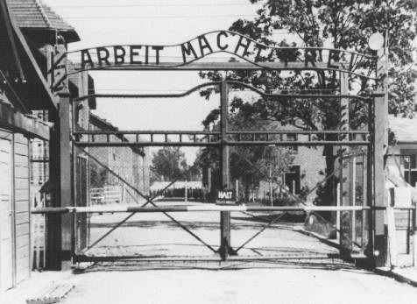
I notice…
I wonder…
What if…

Slide 3
Language of Chapter 1 Words to know:
Admonished perils excessive vanity
Peruse cemented to skirt unwillingly
Anti-Semitism exile persecution
Deported squalor fretted
Courtly blithe disquiet
Slurs caricatures depicting
propaganda inflamed leering
progressively venture swastika
Juvenile delinquents

Slide 4
Chapter 1 Discussion Questions
3. Referring to the map on page 53, explain what happened when Hitler gave the northern part of Transylvania to Hungary. How did the state of Israel come into being? How were both events significant to the Jews? (application) DOK2
4. Why did Eva emerge as an outspoken leader among her siblings? Why did she often argue with her father? Describe how their disagreements later prepared her for survival. (analysis) DOK2
5. When Eva and Miriam were mistreated at school, what advice did their parents offer? Was it effective? What advice would you have given? Why? (synthesis) DOK2
6. Why did Eva’s mother refuse to leave Portz to live in Palestine? Considering she did not know what the future would hold, did she make the right decision at the time? Would you have left your home under similar circumstances? Explain your reasoning. (evaluation) DOK2
1. What language did Eva’s parents speak to each other when they did not want the children to know what they were saying? (knowledge) DOK1
2. When and how did Eva’s neighbors’ attitude toward Jews begin to change? Cite evidence from the text to support your answer. (comprehension) DOK2

Slide 5
Chapter 1 Predict: Life Connection:
Will Eva or one of her family members fi ght back against those who mistreated them? Why or why not? DOK2
Bullying can take many forms. Bystanders can help with this epidemic by speaking up against the mistreatment of others. How differently would Eva and Miriam’s school life had been if someone had spoken up for them? Is there ever a reason to stand by if bullying is happening? Has there ever been a time when you stood up for someone else? If not, was there a time that you should have?

