Slide 1
Surviving the angel of death: Chapter 10
Eva Mozes Kor and Lisa Rojany Buccieri

Slide 2
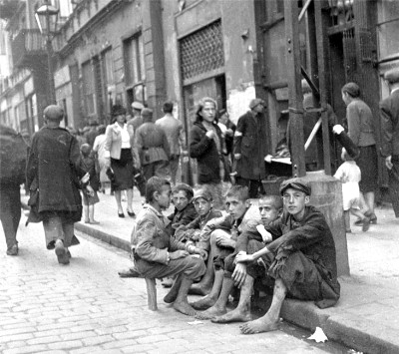
I notice…
I wonder…
What if…

Slide 3
Language of Chapter 10 Words to know:
merriment mused
reverie to take stock
Shirley Temple fascists

Slide 4
Chapter 10 Discussion Questions
4. Why do the Soviets have the prisoners repeat their march out of the camp over and over? Who is at the front of the line? Why? Look at the photo on the front cover of the book (seen in full on page 99). Does this photo elicit the emotions that the Soviets had hoped? (analysis) DOK2
5. How will Eva’s and Miriam’s experiences in the camp help them survive outside of the camp? Use evidence from the text to support your predictions. (synthesis) DOK2
6. What are the “treasures” that Eva and Miriam carry out of the camp? How do these compare with the treasures the family carried when they left their tent to board the cattle car? (analysis) DOK2
How does the crowd celebrate their freedom that first night? (knowledge)DOK1
What makes Eva temporarily “tune out” of the celebration? (comprehension) DOK1
Read the “no more” list that Eva and Miriam compile. Make another list of things they’ve experienced at the camp that they may still have to endure now that they are free. (synthesis) DOK1

Slide 5
Chapter 10 Predict: Life Connection:
Will Eva and Miriam be allowed to stay together? How will they travel to the next place and how long might it take? DOK1
When Eva and Miriam were liberated, they experienced some moments of joy—joy that their experience was over and joy that they might soon go home. Why is joy important? What role could it possibly play in a place like Auschwitz? Have you ever witnessed joy in unlikely places? What is the most joyful that you have ever been?

