Slide 1
Surviving the angel of death: Chapter 11
Eva Mozes Kor and Lisa Rojany Buccieri

Slide 2
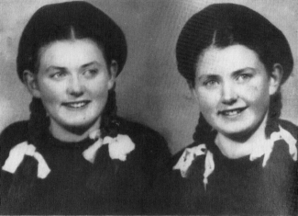
I notice…
I wonder…
What if…

Slide 3
Language of Chapter 11 Words to know:
monitored monastery
convert displaced
conceal khaki
tunics ruble

Slide 4
Chapter 11 Discussion Questions
4. How does Eva react to the items that the nuns have put in her room at the monastery? Why does she react this way? (analysis) DOK2
5. Back in the camp, Eva was sure her parents and older sisters had perished in the camp. Why has her hope been renewed? What infl uenced her change in thinking? Use evidence from the text to support your answer. (synthesis) DOK2
6. Evaluate the traits of Mrs. Csengari’s character. Give evidence from the text to support your view. (evaluation) DOK2
Why doesn’t Eva know about countries like Poland and the Soviet Union? (knowledge) DOK1
Why does the Soviet soldier fi re his gun when Eva tries to take the flour? Why does she think he fi red? (comprehension) DOK1
Why does Eva finally feel that she and Miriam are part of a family again with Mrs. Csengari and Mrs. Goldenthal? What makes you feel “at home” when you are not with your family? (application) DOK2

Slide 5
Chapter 11 Predict: Life Connection:
What will Eva and Miriam fi nd when they reach Portz? How will their former neighbors react? DOK2
In this chapter Mrs. Csengari and Mrs. Goldenthal vow to tell the world what happened to them in the camps. Similarly, many people who go through traumatic events wish to share their experiences with others. What is the purpose of this? What are possible effects of this sharing? Why do all types of survivors feel that this is extremely important? Have you ever learned anything from someone else’s story?

