Slide 1
Surviving the angel of death: Chapter 13
Eva Mozes Kor and Lisa Rojany Buccieri

Slide 2
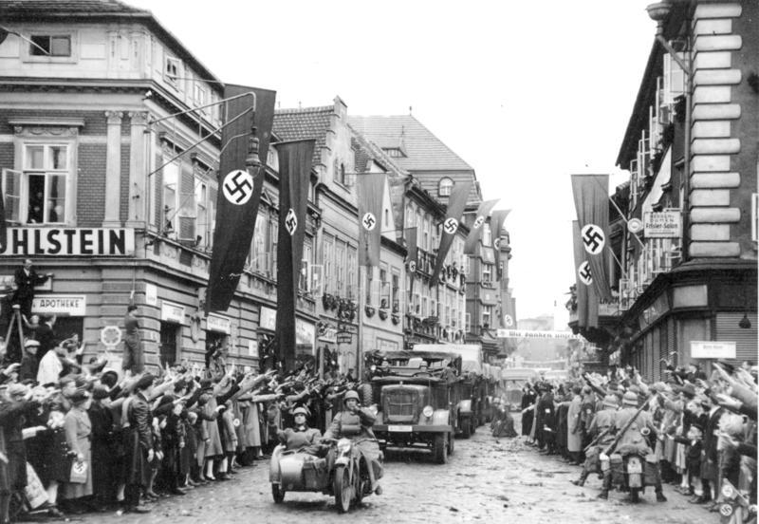
I notice…
I wonder…
What if…

Slide 3
Language of Chapter 13 Words to know:
extensively perished
possessions yearned
porcelain malnutrition
veranda raided
seized persecuted
Zionist ravaged

Slide 4
Chapter 13 Discussion Questions
3. When Eva and Miriam leave Romania for Israel, why do they only take the clothing they are wearing and the family photos? If you were in a similar situation, what clothing would you take? Which three photos would you bring with you? Why? (application)DOK1
4. How has communism changed life in Cluj? Cite examples from the text to support your answer. (analysis) DOK2
5. In what ways does the family manage to get enough food to eat? Is this part of the communists’ plan? Why or why not? (synthesis) DOK2
6. Eva thinks that Aunt Irene’s pre-war possessions mean more to her than her own nieces. Do you agree? Why or why not? Cite evidence from the text to justify your answer. (evaluation) DOK2
How long do Eva and Miriam live with their aunt? (knowledge) DOK1
When Eva refl ects back on life with Aunt Irene, she says, “...we were not really a family.” What does she mean? Use details from the text to justify your reasoning. (comprehension) DOK2

Slide 5
Chapter 13 Predict: Life Connection:
What will life in Israel be like for Eva and Miriam? After reading letters from her uncle Aaron in Haifa, Eva thought Israel sounded like a paradise. Will she be disappointed? Why or why not? DOK2
Aunt Irene was the only family that Eva and Miriam had, but living there didn’t feel like home. Family means something different to everyone, as does the word home. Explain what they mean to you. Do you think that your ideas about home and family will ever change?

