Slide 1
Surviving the angel of death: Chapter 14
Eva Mozes Kor and Lisa Rojany Buccieri

Slide 2
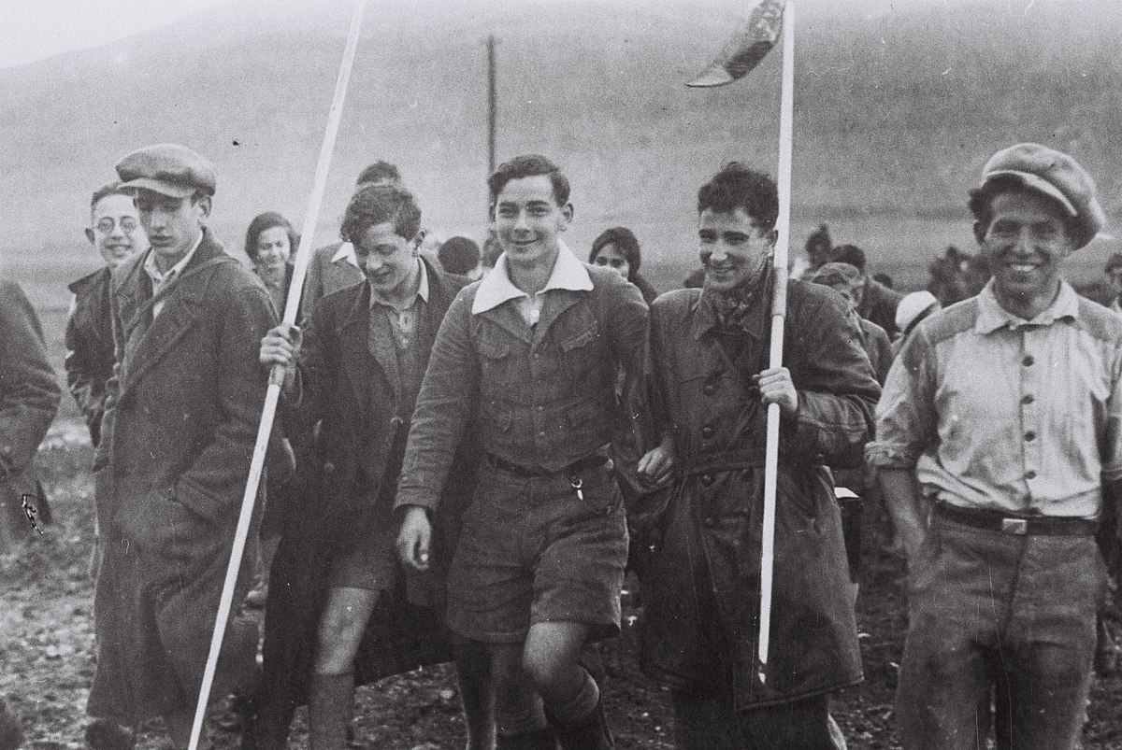
I notice…
I wonder…
What if…

Slide 3
Language of Chapter 14 Words to know:
dormitory
housemother

Slide 4
Chapter 14 Discussion Questions
4. What does Eva discover about her favorite cousin, Aunt Irene’s son? Why didn’t Irene tell the girls the truth? Should she have? Why or why not? (analysis) DOK2
5. Eva says that not all of the youth in the village are Holocaust survivors, yet they all became friends. What challenges and rewards might Eva have experienced when forming friendships with those who had not suffered in the concentration camps? (synthesis) DOK3
6. Throughout her story, Eva has searched for a true sense of family. Does she find it in Israel? Explain your answer. (analysis) DOK2
Describe Eva’s daily schedule. (knowledge) DOK1
What is the purpose of the Youth Aliyah Villages? What does Eva do there? (comprehension) DOK1
Eva learned a few phrases in Hebrew the first night she and Miriam spent in the village. Visit a site such as http://www.linguanaut.com/english_hebrew.htm and learn some basic Hebrew phrases. Which ones do you think Eva might have learned first? (application) DOK3

Slide 5
Chapter 14 Predict: Life Connection:
How will Eva and Miriam do in school? How long will they stay in Israel? How will freedom change them? DOK2
Happiness can be found by getting involved in causes bigger than yourself. Eva learned this lesson from her mother, Jaffa, who was known for helping young mothers in Portz and opening her home to strangers and travelers passing through the village. She also learned this in Israel, as she took care of plants and animals. Today Eva challenges others to do something each day to improve the world and ourselves. Perhaps say hello, smile, pay a compliment, pick up trash, help a neighbor, or show kindness and care. By reaching out to help people, we unleash happiness inside ourselves.

