Slide 1
Surviving the angel of death: Chapter 2
Eva Mozes Kor and Lisa Rojany Buccieri

Slide 2
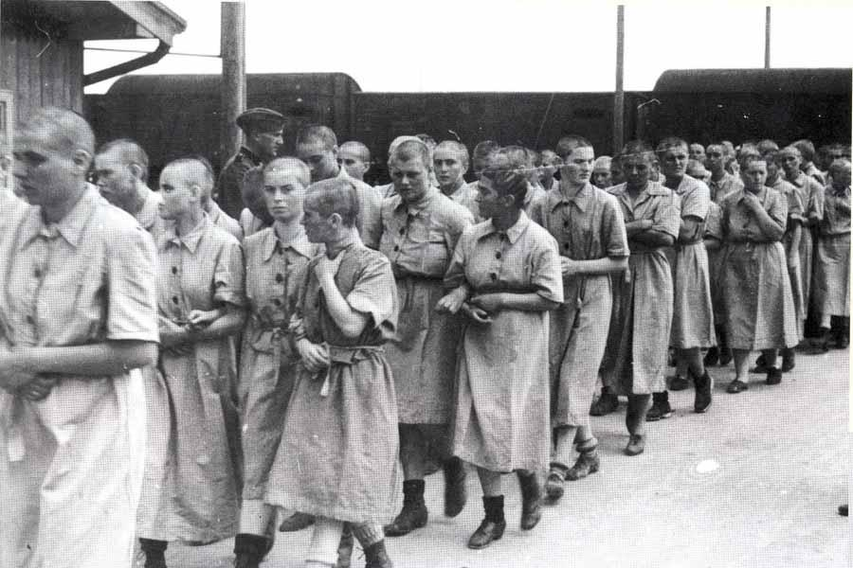
I notice…
I wonder…
What if…

Slide 3
Language of Chapter 2 Words to know:
typhoid fever house arrest abrupt
harassment run-down interrogation
valuables rationed gnawing
deprivation withdrawn circulating
stifling exposed despair
solemnly

Slide 4
Chapter 2 Discussion Questions
4. When the Mozes family was forced to leave camp to board the train, they each took a few “valuables” from their tent. Why did Eva and Miriam choose to bring their matching dresses as their valuables? (analysis)DOK2
5. How does Eva’s view of her parents shift? How will this shift affect Eva’s actions from now on? Give examples of how Eva might handle herself now compared with how she might have reacted a few months earlier. Cite evidence from the text to support your answer. (synthesis)DOK2
6. The Nazis put Eva’s father “in charge” of the people in the cattle car, saying that anyone caught trying to escape would be shot. Discuss why the Nazis did this. Was it possible for anyone to escape? If it had been, would anyone have tried? Why or why not? (evaluation) DOK2
Why didn’t Eva and Miriam get to celebrate their tenth birthday? (knowledge)DOK1
Why were Eva and the others terrified to hear German spoken at their final destination? Use evidence from the text to support your answer. (comprehension) DOK1
How did the villagers, including her best friend Luci, react when Eva and her family were taken away by the Nazis? Why wasn’t Eva surprised? If you had lived in Eva’s village at the time, what might you have done as the Mozes family was taken away? (application) DOK2

Slide 5
Chapter 2 Predict: Life Connection:
What will happen now that Eva and the others have stepped out of the cattle car and onto the platform? List a few possible scenarios and how Eva might react to each one. DOK3
There are often times in our lives when our opinions of people change. This can happen positively or negatively. Like Eva in the book, many people have shifting feelings about family members over the course of time. Has there ever been a time when your opinion of a loved one changed? Was this a positive thing? What would it take for your view to change again?

