Slide 1
Surviving the angel of death: Chapter 4
Eva Mozes Kor and Lisa Rojany Buccieri

Slide 2
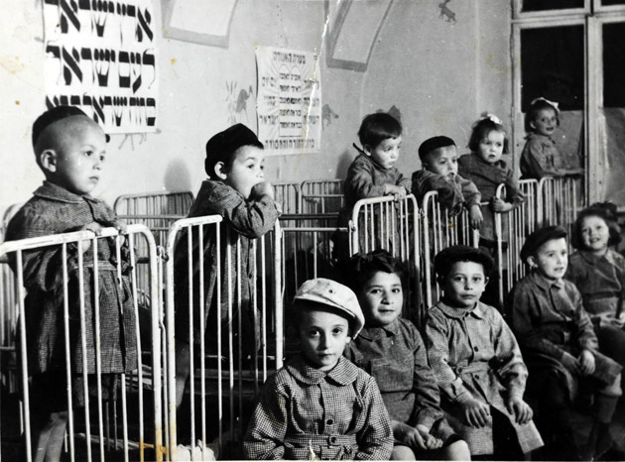
I notice…
I wonder…
What if…

Slide 3
Language of Chapter 4 Words to know:
instinctively disposed of procedure
twitchy entourage escorted
petrified baton rations
intervened guinea pigs abnormalities
genetic mutation dehumanizing
meager phooey swine
taunting

Slide 4
Chapter 4 Discussion Questions
4. Why didn’t the girls in the barracks know each others’ names? What effect, positive or negative, might this have had on their survival? (analysis) DOK2
5. What were Dr. Mengele’s public goals in conducting the experiments? What do you think his personal reasons for conducting the experiments may have been? Explain your answer. (synthesis) DOK2
6. How does the staff react when Dr. Mengele enters the room? How do the twins react? Why do they react this way? Why was Dr. Mengele so powerful? Cite evidence from the text to support your answer. (evaluation) DOK3
1. Who arrives in the barracks? (knowledge) DOK1
2. What do Eva and Miriam learn about the routines of barracks life? (comprehension)
DOK1
3. Compare and contrast the experience of
the male and female twins. Cite evidence from the text to support your answers. (application) DOK2

Slide 5
Chapter 4 Predict: Life Connection:
What kinds of experiments will Eva, Miriam and the other twins have to endure? DOK2
In this chapter the twins were subjected to cruel treatment by “The Snake”. She was prejudiced against the prisoners because they were Jewish. Have you ever experienced prejudice? Have you ever been prejudiced? Prejudice is not limited to race; you could prejudice someone in many ways. How can you help others and speak out against prejudice in your own life?

