Slide 1
Surviving the angel of death: Chapter 5
Eva Mozes Kor and Lisa Rojany Buccieri

Slide 2
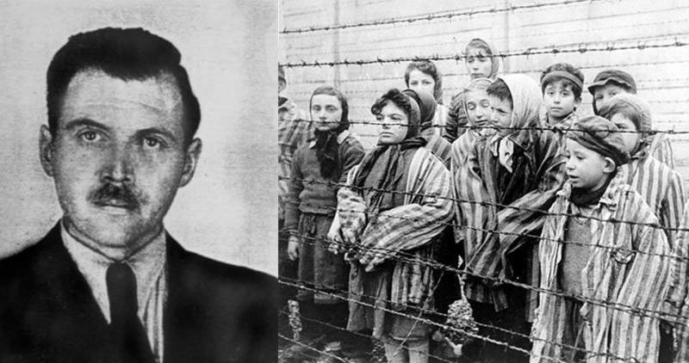
I notice…
I wonder…
What if…

Slide 3
Language of Chapter 5 Words to know:
infested coped pathetic
melded withdrew vial
anguish crescendoing
sedative perish punctuated
pervasive

Slide 4
Chapter 5 Discussion Questions
4. What does Dr. Mengele call the twins? What do some of the twins call him? Why do you think they call him this? Why doesn’t Eva do the same? How might this name for Dr. Mengele help or hinder the twins’ ability to cope with life in the camp? (analysis) DOK2
5. How do the twins in the barracks help each other? If Eva or Miriam become sick, how could the others help? What options do ill prisoners have? Cite evidence from the text. (synthesis) DOK2
6. Eva is reminded of her parents and older sisters only when she sees a cart roll by carrying dead prisoners. Why do you think she hasn’t thought of them until now? Is this an effective way of coping with her situation? What might have happened if Eva had kept her family in her thoughts daily? (evaluation) DOK2
1. Describe the twins’ weekly schedule. (knowledge) DOK1
2. Why doesn’t Eva see herself as “skinny and pathetic” like the boys? (comprehension) DOK1
3. When Eva is given the shots, why doesn’t she cry out in pain? Tell or write about a time in which you refused to show pain. Why did you react the way you did? If you had it to do over, would you react in the same way? (application) DOK2

Slide 5
Chapter 5 Predict: Life Connection:
Will either Eva or Miriam be injected with an illness? Will they be separated? If so, how will they cope? DOK2
Throughout the book, Eva exhibits a unique set of coping mechanisms that help her through extremely challenging situations. What are some coping skills that you have used in the past? How have they helped you? Where did you learn them? Do you think that Eva’s personality had anything to do with the mechanisms that she chose?

