Slide 1
Surviving the angel of death: Chapter 6
Eva Mozes Kor and Lisa Rojany Buccieri

Slide 2
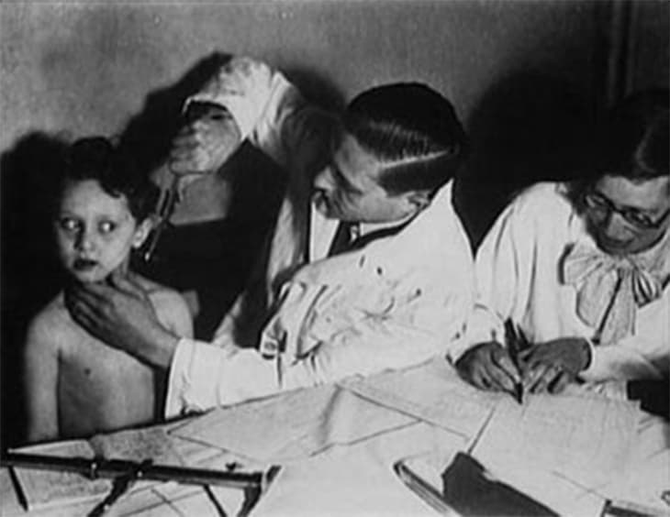
I notice…
I wonder…
What if…

Slide 3
Language of Chapter 6 Words to know:
fatigue infirmary
air raid sirens putrid stench
willpower silhouette
devoured humane
solitary confinement
pathologist autopsies
simultaneous

Slide 4
Chapter 6 Discussion Questions
4. How does Eva react when she hears Dr. Mengele say that she’ll be dead within two weeks? How does her determination factor into her survival? Cite evidence from the text to support your answers. (analysis) DOK2
5. Considering what you know about Eva’s and Miriam’s personalities, what could Eva do that would help Miriam? Describe two possible scenarios using details from the text. (synthesis) DOK2
6. What does Eva later learn about Dr. Mengele’s experiments? For whom does he claim he was conducting these experiments? How does the world view his methods? (evaluation) DOK2
What effect does the injection have on Eva? (knowledge) DOK1
Why doesn’t Eva want to tell anyone except Miriam about her symptoms? (comprehension)DOK1
Why does Miriam tell Eva to leave her alone once they’re reunited? Rewrite or narrate this chapter as it may have looked from Miriam’s point of view. (application) DOK3

Slide 5
Chapter 6 Predict: Life Connection:
Will Eva’s efforts to help Miriam turn out to be successful? Why or why not? DOK2
In this chapter, Eva exhibits great perseverance as she conquers death after a deadly injection. Throughout her life, she has lived by the motto “Never Ever Give Up”. How does this apply to your life? Was there ever a time when you gave up when you wish you hadn’t? Is it ever appropriate to give up?

