Slide 1
Surviving the angel of death: Chapter 7
Eva Mozes Kor and Lisa Rojany Buccieri

Slide 2
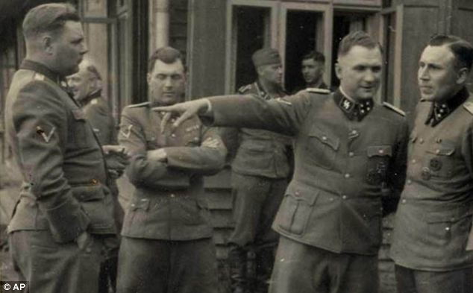
I notice…
I wonder…
What if…

Slide 3
Language of Chapter 7 Words to know:
incessant victorious
imperative gallows
deliberately tongue-lashing
cache brigade

Slide 4
Chapter 7 Discussion Questions
4. When Eva and the other twins were made to witness a hanging as a deterrent to escape, Eva thought: “Yes, life is so wonderful here. Why on earth would we try to escape?” Why does she choose these words? What do they reveal about her character? (analysis) DOK2
5. Eva says, “At Auschwitz dying was so easy. Surviving was a full-time job.” Why would she say this? Do you think the other twins would agree? Why or why not? (synthesis) DOK3
6. What went through Eva’s mind before she stole her first potato? This illustrates a type of conflict called character vs. self. Name other examples of this type of conflict, as well as others including: character vs. character, society and nature. Which confl ict do you think was the hardest for Eva and the twins? Why? (evaluation)DOK3
What do Eva and the other twins believe will cure their dysentery? (knowledge) DOK1
What does “organizing” mean? Why do you think the prisoners used this term? (comprehension) DOK1
Eva says, “...my sister would have died then if it had not been for me. And in turn, taking care of Miriam had helped me become sturdier and more forceful, too.” Tell or write about a time when helping someone else reaped positive effects for you. (application) DOK2

Slide 5
Chapter 7 Predict: Life Connection:
Since American planes have already flown over the camp, how much longer will the twins need to survive before they are freed? What percentage of them will survive the camp? DOK2
In the camps, “organizing” was a means of survival. Today, this would be considered against the law. We are taught from a very young age, not to break the law or question authority. Is breaking a law, such as stealing, ever morally appropriate? Can you think of any situations where you might be driven to do so? Would this choice be a reflection of your character?

