Slide 1
Surviving the angel of death: Chapter 8
Eva Mozes Kor and Lisa Rojany Buccieri

Slide 2
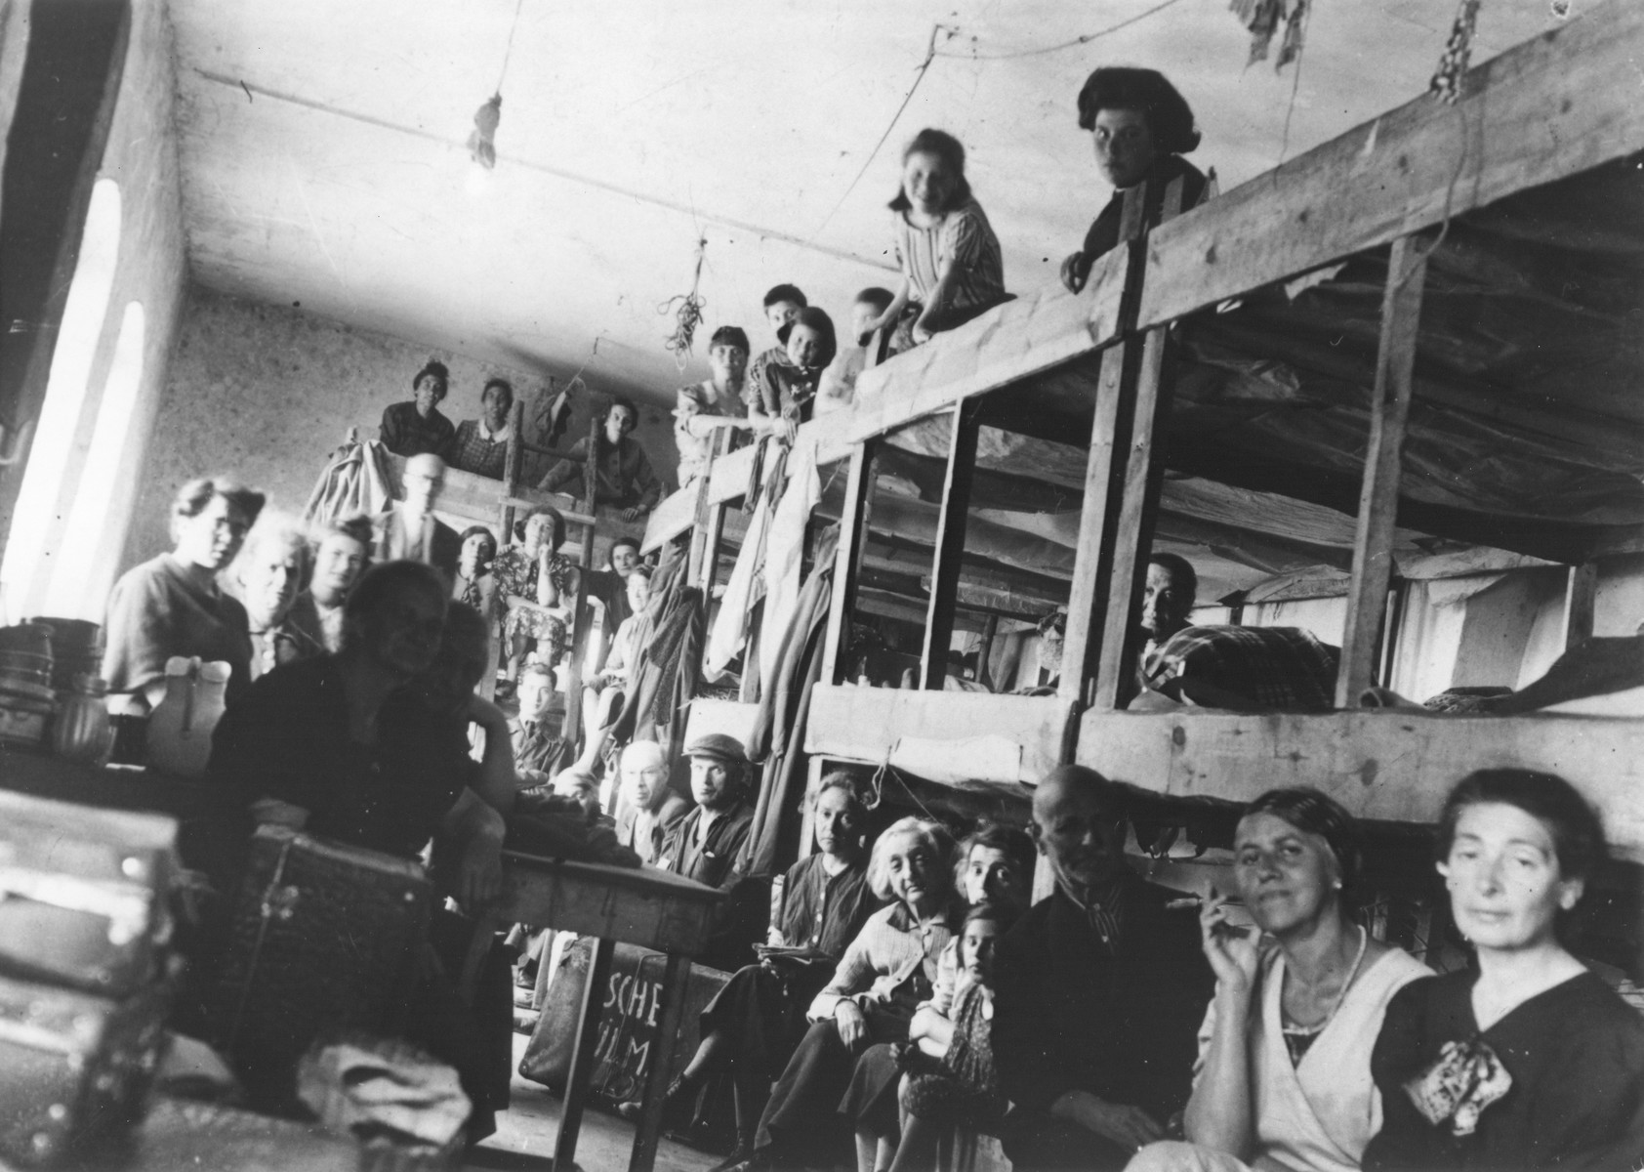
I notice…
I wonder…
What if…

Slide 3
Language of Chapter 8 Words to know:
incinerated dread
atrocities abundance
rummaged searing
surged jostled
inexplicably emaciated
garb stupor
lurch scrawny
savored entwined

Slide 4
Chapter 8 Discussion Questions
3. Tell about a time when you were accidentally separated from a loved one. How did you feel? How did you react? (application) DOK1
4. What saves Eva from the shooting? What is her first reaction when she awakes? What is her first priority? How might her reaction have differed if the shooting had taken place a year earlier in her hometown? (analysis) DOK2
5. How has their 24-hour separation changed Eva and Miriam? How will this experience impact their mode of survival from now on? (synthesis) DOK2
6. Eva tells Miriam, “This is our lucky barracks!” Is she right? Why or why not? (evaluation) DOK2
1. Why do Eva and the other twins have to endure an eleven-hour roll call? (knowledge) DOK1
2. What are the signs that the war was coming to an end? Why do the prisoners have mixed feelings? (comprehension) DOK1

Slide 5
Chapter 8 Predict: Life Connection:
Where are the prisoners now? Are they more or less likely to be freed by the allies? DOK2
During this portion of the book, several prisoners express mixed feelings about the possibility of liberation. Fear of change is extremely common, especially after a traumatic event. What types of change would be frightening to you? Think about the times in your life when big changes have happened. What might have happened if those changes had never taken place?

