Slide 1
Surviving the angel of death: Chapter 9
Eva Mozes Kor and Lisa Rojany Buccieri

Slide 2
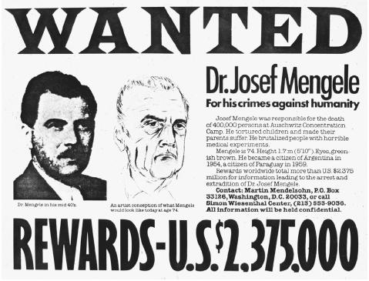
I notice…
I wonder…
What if…

Slide 3
Language of Chapter 9 Words to know:
luxurious delectable
sauerkraut scrounging
unleavened bloated
scavenging inconceivable
raged indiscriminately
bunkers liberation
pall smirks
welled

Slide 4
Chapter 9 Discussion Questions
3. Write or narrate the scene by the river from the schoolgirl’s point of view. (application)DOK3
4. Discuss the symbolism of the baking of the bread in this chapter. Use evidence from the text to support your answer. (analysis) DOK2
5. If Eva could have spoken to the girl by the river, what might their exchange have been like? Write an example dialogue of the conversation. (synthesis) DOK2
6. Based on the last page of the chapter, how do you think the Soviet soldiers will treat the prisoners? Write an example of what you think the first paragraph of the next chapter be. (evaluation) DOK2
What are Eva’s and Miriam’s daily tasks in the “lucky barracks”? (knowledge) DOK1
Why have the Nazis left behind a table full of food in their headquarters? (comprehension) DOK1

Slide 5
Chapter 9 Predict: Life Connection:
What will become of Eva and the others now? What will be the joys and challenges of freedom?
There is a moment in the text where Eva sees another little girl and realizes suddenly how different her life is in Auschwitz. This causes some feelings of anger to rise within her. Can you be different in a positive way? In what way are Eva’s differences also positive character attributes? Will they serve her in any way in the future? In what ways are you different from your peers? Does that set you apart in a positive or negative way?

