Slide 1
Surviving the angel of death: epilogue
Eva Mozes Kor and Lisa Rojany Buccieri

Slide 2
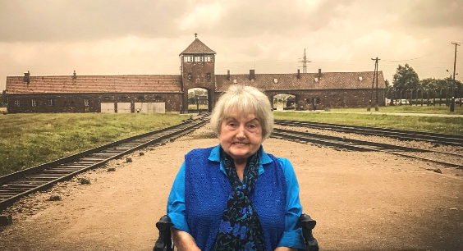
I notice…
I wonder…
What if…

Slide 3
Language of the Epilogue Words to know:
drafted draftsperson
liberator engrossed
proceeded hermetically
orifice intermingled
affidavit perpetrator
germinate amnesty

Slide 4
Epilogue Discussion Questions
4. Why did Eva and Miriam found the CANDLES support group? Why did Eva found the CANDLES Holocaust Museum and Education Center? Whom has the museum benefited and in what ways? Using Eva’s memoir and secondary sources, create an argument about the need for Holocaust Education. (analysis) DOK1
5. What is Eva’s message to you, the reader? Drawing on all of the knowledge you have gained during your reading, what is your message to her? (evaluation) DOK3
6. Why did Eva write a letter of forgiveness to Dr. Münch? What effect did it have on Eva? Whom else did Eva forgive? Do you agree with her decision? Why or why not? (synthesis) DOK3
1. What jobs did Eva hold in Israel? (knowledge) DOK1
Describe Eva’s courtship with Michael. (comprehension) DOK1
Eva says that coming from Israel to Indiana was like “landing on the moon.” What does she mean? List ways to help someone who has recently moved to a new country. How might your suggestions have changed Eva’s early experiences in the United States? (synthesis) DOK3

Slide 5
Epilogue Predict: Life Connection:
How will Eva’s story continue to affect people? How has it affected you? DOK2
The way to remove prejudice and hatred from the world is to begin one person at a time. Become a light that illuminates the darkness.
On November 18, 2003, an arsonist set fi re to CANDLES Holocaust Museum and Education Center. The museum building and its contents were destroyed. Eva stood quietly in the rain that night, while firefighters did their best to salvage anything they could find.
Eva had a choice that night: She could throw up her hands in defeat, not able to fight against the hatred that seemed to extinguish her life’s work. Or she could rebuild. Harnessing the tremendous outpouring of support from the community and nation, Eva reopened CANDLES in April 2005.
You don’t have to be as ambitious as Eva to change lives. What can you do to change your own corner of the world? In what ways can one person make a difference?

