Slide 1
Surviving the angel of death: Prologue
Eva Mozes Kor and Lisa Rojany Buccieri

Slide 2
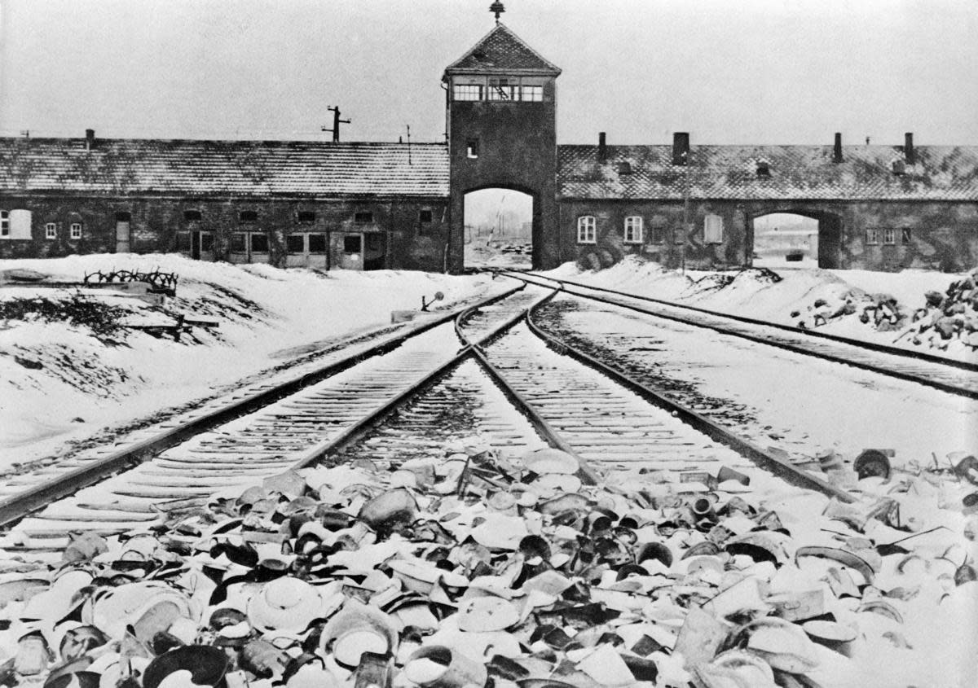
I notice…
I wonder…
What if…

Slide 3
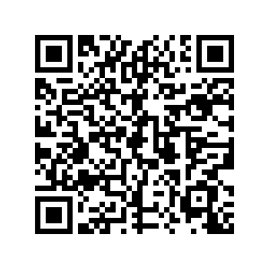
Pre-Reading
Nazi Camp System
1. Look at the title and cover. What feelings does the photograph on the back cover elicit? Which terms in the title are familiar to you? Which terms are not familiar?
2. Read the book dedication. What is this story about? Make a t-chart with the background knowledge you’ll bring to the story and questions you have before reading.
3. Visit ushmm.org and read the sections titled “The Final Solution” and “Nazi Camp System” to build your background knowledge for the novel.
4. Have you ever been separated from your family? Write or tell about your experiences. What were the pros and cons?
The Final Solution

Slide 4
Language of the Prologue Words to Know:
Crammed cattle car desperate
Platform release nipping
Barbed-wire SS patrols rabid
Clenched actuality concentration camp
Labor camp digest jostled
Jammed escalating selection
Erupted pandemonium bedlam
Chaos despair grimy
abrubtly

Slide 5
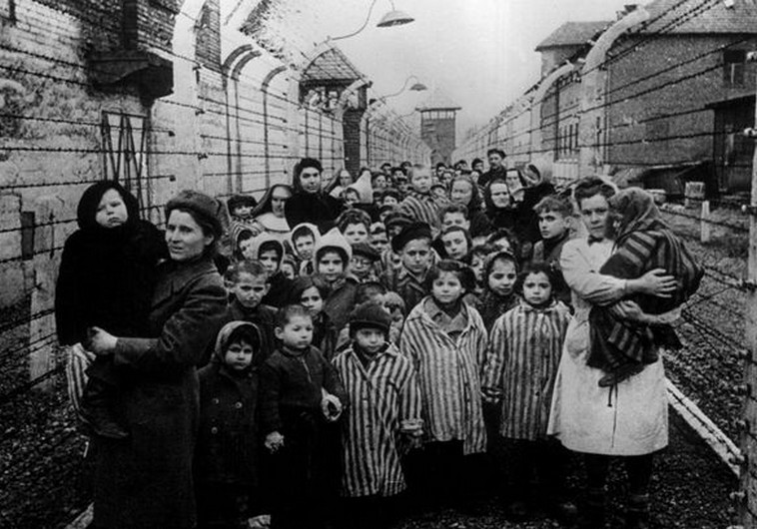
I notice…
I wonder…
What if…

Slide 6
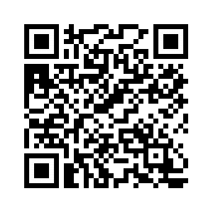
Discussion Questions:
3. Compare the maps on pages 52 and 53
with a map of Germany in 1944 (go to http:
//www.ushmm.org/ and search for
“Greater Germany 1944,” then click on
“map”). What had happened to Poland by
the time Eva and her family arrived there
in 1944? How do the maps help you to
understand that information? (application) DOK2
4. How does the author describe light in this chapter? How does each description reflect the mood in each scene? Cite evidence from the text to support your answers. (analysis) DOK2
5. Eva says that Dr. Josef Mengele “...selected those on the platform who were to live and those who would die.” How did he make his selections? List the reasons why he might have separated Eva and Miriam from the rest of their family? (analysis) DOK2
6. Why do you think Eva and the others on the train were not told where they were going? Rewrite that scene of the chapter as if they had known beforehand using only dialogue. What changed? (evaluation) DOK3
1. From which country did Eva’s family come? Where did they think they were going on the train compared to where the train took them? (knowledge) DOK1
2. When the SS soldier asked Eva’s mother if the girls were twins, why did she hesitate before answering? (comprehension) DOK2

Slide 7
Prologue Predict: Life Connection:
Will Eva and Miriam be separated? Will Miriam survive? Cite evidence from the text to support your thinking. DOK2
Strength of character can be defined as the power to remain true to yourself and your values while facing incredible challenges. During the prologue, Eva has already begun to exhibit strength of character. What does strength of character mean to you? Have you ever faced a challenge in which your character was tested?

